Slide 1
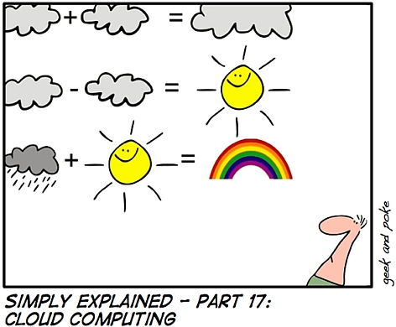
What is Cloud Computing?

Slide 2
Using the Cloud to Crunch Your Data
Adrian Cockcroft – acockcroft@netflix.com

Slide 3
What is Capacity Planning
We care about CPU, Memory, Network and Disk resources, and Application response times
We need to know how much of each resource we are using now, and will use in the future
We need to know how much headroom we have to handle higher loads
We want to understand how headroom varies, and how it relates to application response times and throughput

Slide 4
Capacity Planning Norms
Capacity is expensive
Capacity takes time to buy and provision
Capacity only increases, can’t be shrunk easily
Capacity comes in big chunks, paid up front
Planning errors can cause big problems
Systems are clearly defined assets
Systems can be instrumented in detail

Slide 5
Capacity Planning in Clouds
Capacity is expensive
Capacity takes time to buy and provision
Capacity only increases, can’t be shrunk easily
Capacity comes in big chunks, paid up front
Planning errors can cause big problems
Systems are clearly defined assets
Systems can be instrumented in detail

Slide 6
Capacity is expensive http://aws.amazon.com/s3/ & http://aws.amazon.com/ec2/
Storage (Amazon S3)
$0.150 per GB – first 50 TB / month of storage used
$0.120 per GB – storage used / month over 500 TB
Data Transfer (Amazon S3)
$0.100 per GB – all data transfer in
$0.170 per GB – first 10 TB / month data transfer out
$0.100 per GB – data transfer out / month over 150 TB
Requests (Amazon S3 Storage access is via http)
$0.01 per 1,000 PUT, COPY, POST, or LIST requests
$0.01 per 10,000 GET and all other requests
$0 per DELETE
CPU (Amazon EC2)
Small (Default) $0.085 per hour, Extra Large $0.68 per hour
Network (Amazon EC2)
Inbound/Outbound around $0.10 per GB

Slide 7
Capacity comes in big chunks, paid up front
Capacity takes time to buy and provision
No minimum price, monthly billing
“Amazon EC2 enables you to increase or decrease capacity within minutes, not hours or days. You can commission one, hundreds or even thousands of server instances simultaneously”
Capacity only increases, can’t be shrunk easily
Pay for what is actually used
Planning errors can cause big problems
Size only for what you need now

Slide 8
Systems are clearly defined assets
You are running in a “stateless” multi-tenanted virtual image that can die or be taken away and replaced at any time
You don’t know exactly where it is
You can choose to locate “USA” or “Europe”
You can specify zones that will not share components to avoid common mode failures

Slide 9
Systems can be instrumented in detail
Need to use stateless monitoring tools
Monitored nodes come and go by the hour
Need to write role-name to hostname
e.g. wwwprod002, not the EC2 default
all monitoring by role-name
Ganglia – automatic configuration
Multicast replicated monitoring state
No need to pre-define metrics and nodes

Slide 10
Acquisition requires management buy-in
Anyone with a credit card and $10 is in business
Data governance issues…
Remember 1980’s when PC’s first turned up?
Departmental budgets funded PC’s
No standards, management or backups
Central IT departments could lose control
Decentralized use of clouds will be driven by teams seeking competitive advantage and business agility – ultimately unstoppable…

Slide 11
OK, so what should we do?

Slide 12
The Umbrella Strategy
Monitor network traffic to cloud vendor API’s
Catch unauthorized clouds as they form
Measure, trend and predict cloud activity
Pick two cloud standards, setup corporate accounts
Better sharing of lessons as they are learned
Create path of least resistance for users
Avoid vendor lock-in
Aggregate traffic to get bulk discounts
Pressure the vendors to develop common standards, but don’t wait for them to arrive. The best APIs will be cloned eventually
Sponsor a pathfinder project for each vendor
Navigate a route through the clouds
Don’t get caught unawares in the rain

Slide 13
Predicting the Weather
Billing is variable, monthly in arrears
Try to predict how much you will be billed…
Not an issue to start with, but can’t be ignored
Amazon has a cost estimator tool that may help
Central analysis and collection of cloud metrics
Cloud vendor usage metrics via API
Your system and application metrics via Ganglia
Intra-cloud bandwidth is free, analyze in the cloud!
Based on standard analysis framework “Hadoop”
Validation of vendor metrics and billing
Charge-back for individual user applications

Slide 14
Use it to learn it…
Focus on how you can use the cloud yourself to do large scale log processing
You can upload huge datasets to a cloud and crunch them with a large cluster of computers using Amazon Elastic Map Reduce (EMR)
Do it all from your web browser for a handful of dollars charged to a credit card.
Here’s how

Slide 15
Cloud Crunch
The Recipe
You will need:
A computer connected to the Internet
The Firefox browser
A Firefox specific browser extension
A credit card and less than $1 to spend
Big log files as ingredients
Some very processor intensive queries

Slide 16
Recipe
First we will warm up our computer by setting up Firefox and connecting to the cloud.
Then we will upload our ingredients to be crunched, at about 20 minutes per gigabyte
You should pick between one and twenty processors to crunch with, they are charged by the hour and the cloud takes about 10 minutes to warm up.
The query itself starts by mapping the ingredients so that the mixture separates, then the excess is boiled off to make a nice informative reduction.

Slide 17
Costs
Firefox and Extension – free
Upload ingredients – 10 cents/Gigabyte
Small Processors – 11.5 cents/hour each
Download results – 17 cents/Gigabyte
Storage – 15 cents/Gigabyte/month
Service updates – 1 cent/1000 calls
Service requests – 1 cent/10,000 calls
Actual cost to run two example programs as described in this presentation was 26 cents

Slide 18
Faster Results at Same Cost!
You may have trouble finding enough data and a complex enough query to keep the processors busy for an hour. In that case you can use fewer processors
Conversely if you want quicker results you can use more and/or larger processors.
Up to 20 systems with 8 CPU cores = 160 cores is immediately available. Oversize on request.

Slide 19
Step by Step
Walkthrough to get you started
Run Amazon Elastic MapReduce examples
Get up and running before this presentation is over….

Slide 20
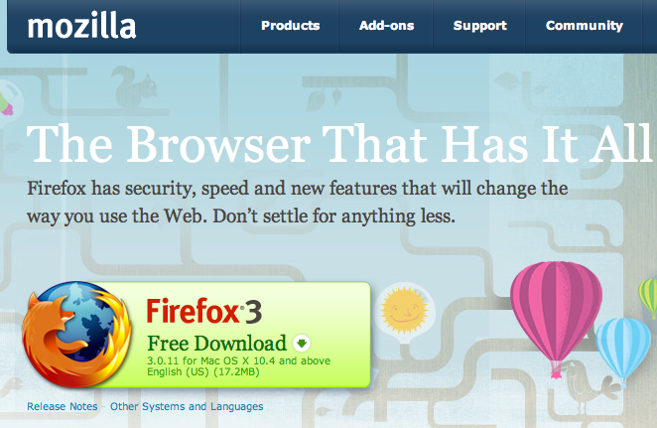
Step 1 – Get Firefox
http://www.mozilla.com/en-US/firefox/firefox.html

Slide 21

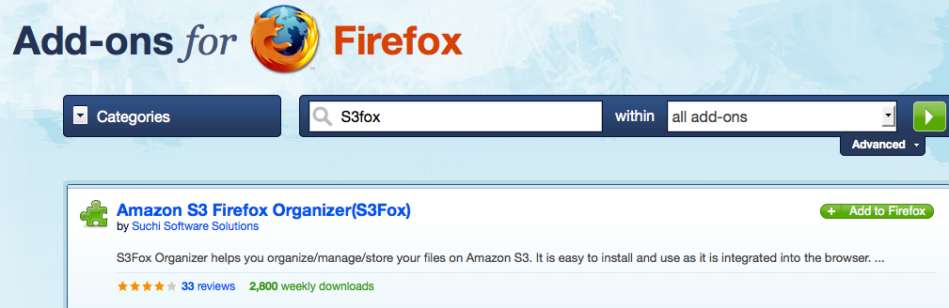
Step 2 – Get S3Fox Extension
Next select the Add-ons option from the Tools menu, select “Get Add-ons” and search for S3Fox.

Slide 22
Step 3 – Learn About AWS
Bring up http://aws.amazon.com/ to read about the services.
Amazon S3 is short for Amazon Simple Storage Service, which is part of the Amazon Web Services product
We will be using Amazon S3 to store data, and Amazon Elastic Map Reduce (EMR) to process it.
Underneath EMR there is an Amazon Elastic Compute Cloud (EC2), which is created automatically for you each time you use EMR.

Slide 23
What is S3, EC2, EMR?
Amazon Simple Storage Service lets you put data into the cloud that is addressed using a URL. Access to it can be private or public.
Amazon Elastic Compute Cloud lets you pick the size and number of computers in your cloud.
Amazon Elastic Map Reduce automatically builds a Hadoop cluster on top of EC2, feeds it data from S3, saves the results in S3, then removes the cluster and frees up the EC2 systems.

Slide 24
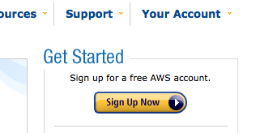
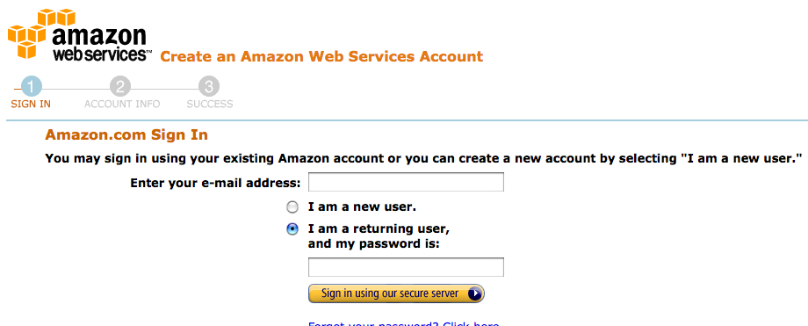
Step 4 – Sign Up For AWS
Go to the top-right of the page and sign up at http://aws.amazon.com/
You can login using the same account you use to buy books!

Slide 25
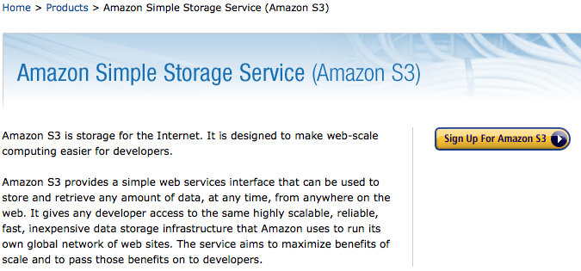
Step 5 – Sign Up For Amazon S3
Follow the link to http://aws.amazon.com/s3/

Slide 26
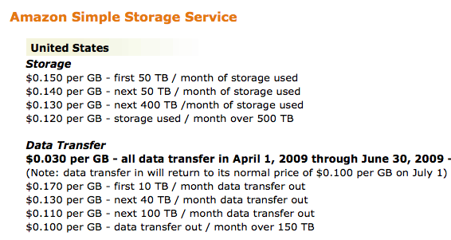
Check The S3 Rate Card

Slide 27
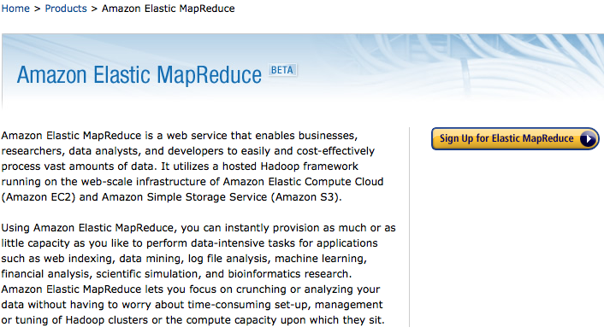
Step 6 – Sign Up For Amazon EMR
Go to http://aws.amazon.com/elasticmapreduce/

Slide 28
EC2 Signup
The EMR signup combines the other needed
services such as EC2 in the sign up process and the rates for all are displayed.
The EMR costs are in addition to the EC2 costs, so 1.5 cents/hour for EMR is added to the 10 cents/hour for EC2 making 11.5 cents/hour for each small instance running Linux with Hadoop.

Slide 29
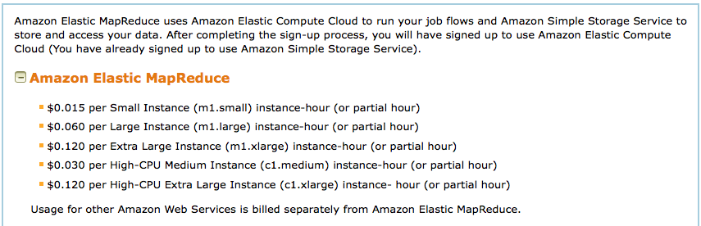
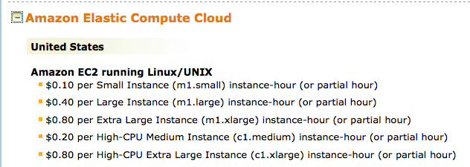
EMR And EC2 Rates (old data – it is cheaper now with even bigger nodes)

Slide 30
Step 7 - How Big are EC2 Instances?
See http://aws.amazon.com/ec2/instance-types/
The compute power is specified in a standard unit called an EC2 Compute Unit (ECU).
Amazon states “One EC2 Compute Unit (ECU) provides the equivalent CPU capacity of a 1.0-1.2 GHz 2007 Opteron or 2007 Xeon processor.”

Slide 31
Standard Instances
Small Instance (Default) 1.7 GB of memory, 1 EC2 Compute Unit (1 virtual core with 1 EC2 Compute Unit), 160 GB of instance storage, 32-bit platform.
Large Instance 7.5 GB of memory, 4 EC2 Compute Units (2 virtual cores with 2 EC2 Compute Units each), 850 GB of instance storage, 64-bit platform.
Extra Large Instance 15 GB of memory, 8 EC2 Compute Units (4 virtual cores with 2 EC2 Compute Units each), 1690 GB of instance storage, 64-bit platform.

Slide 32
Compute Intensive Instances
High-CPU Medium Instance 1.7 GB of memory, 5 EC2 Compute Units (2 virtual cores with 2.5 EC2 Compute Units each), 350 GB of instance storage, 32-bit platform.
High-CPU Extra Large Instance 7 GB of memory, 20 EC2 Compute Units (8 virtual cores with 2.5 EC2 Compute Units each), 1690 GB of instance storage, 64-bit platform.

Slide 33
Step 8 – Getting Started
http://docs.amazonwebservices.com/ElasticMapReduce/2009-03-31/GettingStartedGuide/
There is a Getting Started guide and Developer Documentation including sample applications
We will be working through two of those applications.
There is also a very helpful FAQ page that is worth reading through.

Slide 34
Step 9 – What is EMR?

Slide 35
Step 10 – How To MapReduce?
Code directly in Java
Submit “streaming” command line scripts
EMR bundles Perl, Python, Ruby and R
Code MR sequences in Java using Cascading
Process log files using Cascading Multitool
Write dataflow scripts with Pig
Write SQL queries using Hive

Slide 36
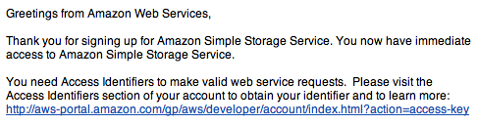
Step 11 – Setup Access Keys
Getting Started Guide
http://docs.amazonwebservices.com/ElasticMapReduce/2009-03-31/GettingStartedGuide/gsFirstSteps.html
The URL to visit to get your key is:
http://aws-portal.amazon.com/gp/aws/developer/account/index.html?action=access-key

Slide 37
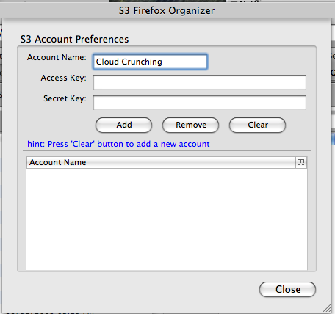
Enter Access Keys in S3Fox
Open S3 Firefox Organizer and select the Manage Accounts button at the top left
Enter your access keys into the popup.

Slide 38
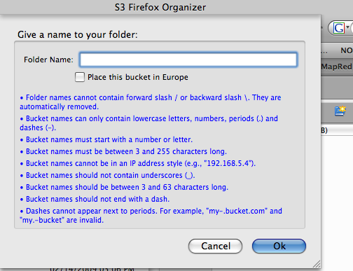
Step 12 – Create An Output Folder
Click Here

Slide 39
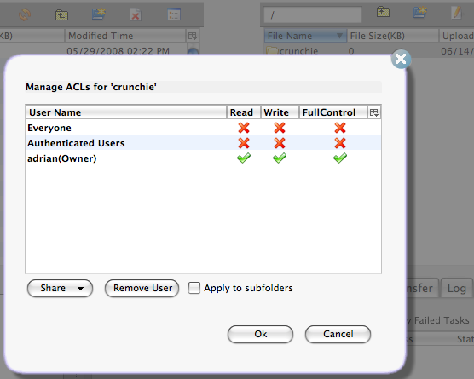
Setup Folder Permissions

Slide 40
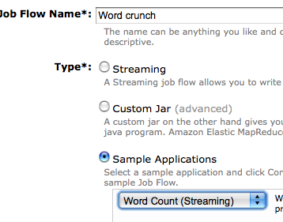
Step 13 – Run Your First Job
See the Getting Started Guide at:
http://docs.amazonwebservices.com/ElasticMapReduce/2009-03-31/GettingStartedGuide/gsConsoleRunJob.html
login to the EMR console at https://console.aws.amazon.com/elasticmapreduce/home
create a new job flow called “Word crunch”, and select the sample application word count.

Slide 41
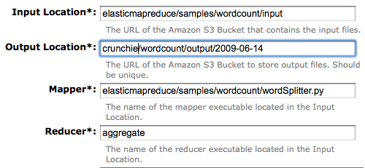
Set the Output S3 Bucket

Slide 42
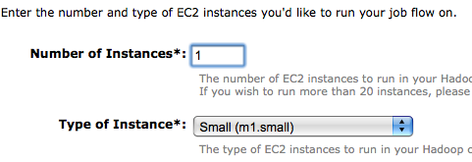
Pick the Instance Count
One small instance (i.e. computer) will do…
Cost will be 11.5 cents for 1 hour (minimum)

Slide 43
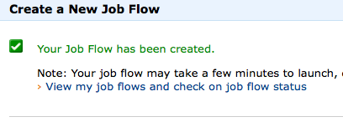
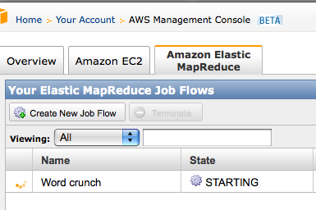
Start the Job Flow
The Job Flow takes a few minutes to get started, then completes in about 5 minutes run time

Slide 44

Step 14 – View The Results
In S3Fox click on the refresh icon, then doubleclick on the crunchie folder
Keep clicking until the output file is visible

Slide 45
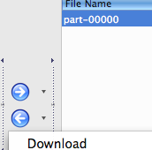
Save To Your PC
S3Fox – click on left arrow
Save to PC
Open in TextEdit
See that the word “a” occurred 14716 times
boring…. so try a more interesting demo!
Click Here

Slide 46
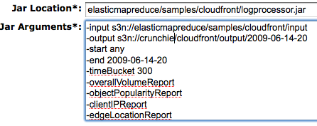
Step 15 – Crunch Some Log Files
Create a new output bucket with a new name
Start a new job flow using the CloudFront Demo
This uses the Cascading Multitool

Slide 47
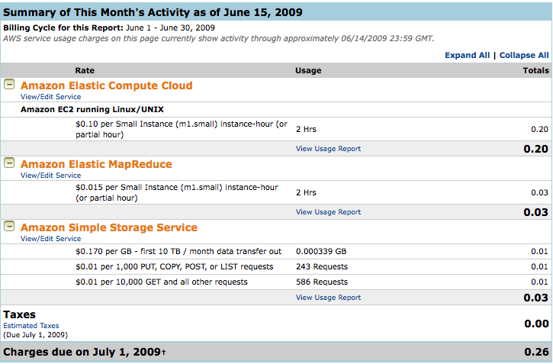
Step 16 – How Much Did That Cost?

Slide 48
Wrap Up
Easy, cheap, anyone can use it
Now let’s look at how to write code…

Slide 49
Log & Data Analysis using Hadoop
Based on slides by
Shashi Madappa
smadappa@netflix.com

Slide 50
Agenda
1. Hadoop
- Background
- Ecosystem
- HDFS & Map/Reduce
- Example
2. Log & Data Analysis @ Netflix
- Problem / Data Volume
- Current & Future Projects
3. Hadoop on Amazon EC2
- Storage options
- Deployment options

Slide 51
Hadoop
Apache open-source software for reliable, scalable, distributed computing.
Originally a sub-project of the Lucene search engine.
Used to analyze and transform large data sets.
Supports partial failure, Recoverability, Consistency & Scalability

Slide 52
Hadoop Sub-Projects
Core
HDFS: A distributed file system that provides high throughput access to data.
Map/Reduce : A framework for processing large data sets.
HBase : A distributed database that supports structured data storage for large tables
Hive : An infrastructure for ad hoc querying (sql like)
Pig : A data-flow language and execution framework
Avro : A data serialization system that provides dynamic integration with scripting languages. Similar to Thrift & Protocol Buffers
Cascading : Executing data processing workflow
Chukwa, Mahout, ZooKeeper, and many more

Slide 53
Hadoop Distributed File System(HDFS)
Features
Cannot be mounted as a “file system”
Access via command line or Java API
Prefers large files (multiple terabytes) to many small files
Files are write once, read many (append coming soon)
Users, Groups and Permissions
Name and Space Quotas
Blocksize and Replication factor are configurable per file
Commands: hadoop dfs -ls, -du, -cp, -mv, -rm, -rmr
Uploading files
hadoop dfs -put foo mydata/foo
cat ReallyBigFile | hadoop dfs -put - mydata/ReallyBigFile
Downloading files
hadoop dfs -get mydata/foo foo
hadoop dfs –tail [–f] mydata/foo

Slide 54
Map/Reduce
Map/Reduce is a programming model for efficient
distributed computing
Data processing of large dataset
Massively parallel (hundreds or thousands of CPUs)
Easy to use
Programmers don’t worry about socket(), etc.
It works like a Unix pipeline:
cat * | grep | sort | uniq -c | cat > output
Input | Map | Shuffle & Sort | Reduce | Output
Efficiency from streaming through data, reducing seeks
A good fit for a lot of applications
Log processing
Index building
Data mining and machine learning

Slide 55
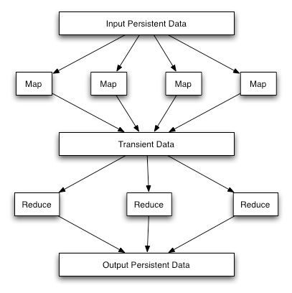
Map/Reduce
Simple Dataflow

Slide 56
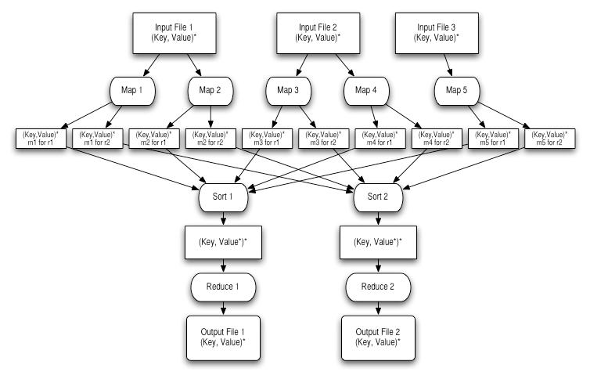
Detailed Dataflow

Slide 57
Input & Output Formats
The application also chooses input and output formats, which define how the persistent data is read and written. These are interfaces and can be defined by the application.
InputFormat
Splits the input to determine the input to each map task.
Defines a RecordReader that reads key, value pairs that are passed to the map task
OutputFormat
Given the key, value pairs and a filename, writes the reduce task output to persistent store.

Slide 58
Map/Reduce Processes
Launching Application
User application code
Submits a specific kind of Map/Reduce job
JobTracker
Handles all jobs
Makes all scheduling decisions
TaskTracker
Manager for all tasks on a given node
Task
Runs an individual map or reduce fragment for a given job
Forks from the TaskTracker

Slide 59
Word Count Example
Mapper
Input: value: lines of text of input
Output: key: word, value: 1
Reducer
Input: key: word, value: set of counts
Output: key: word, value: sum
Launching program
Defines the job
Submits job to cluster

Slide 60
Map Phase
public static class WordCountMapper extends MapReduceBase implements Mapper<LongWritable, Text, Text, IntWritable> {
private final static IntWritable one = new IntWritable(1);
private Text word = new Text();
public void map(LongWritable key, Text value, OutputCollector<Text, IntWritable> output, Reporter reporter) throws IOException {
String line = value.toString();
StringTokenizer itr = new StringTokenizer(line, “,”);
while (itr.hasMoreTokens()) {
word.set(itr.nextToken());
output.collect(word, one);
}
}
}

Slide 61
Reduce Phase
public static class WordCountReducer extends MapReduceBase implements Reducer<Text, IntWritable, Text, IntWritable> {
public void reduce(Text key, Iterator<IntWritable> values, OutputCollector<Text, IntWritable> output, Reporter reporter) throws IOException {
int sum = 0;
while (values.hasNext()) {
sum += values.next().get();
}
output.collect(key, new IntWritable(sum));
}
}

Slide 62
Running the Job
public class WordCount {
public static void main(String[] args) throws IOException {
JobConf conf = new JobConf(WordCount.class);
// the keys are words (strings)
conf.setOutputKeyClass(Text.class);
// the values are counts (ints)
conf.setOutputValueClass(IntWritable.class);
conf.setMapperClass(WordCountMapper.class);
conf.setReducerClass(WordCountReducer.class);
conf.setInputPath(new Path(args[0]);
conf.setOutputPath(new Path(args[1]);
JobClient.runJob(conf);
}
}

Slide 63
Running the Example
Input
Welcome to Netflix
This is a great place to work
Ouput
Netflix 1
This 1
Welcome 1
a 1
great 1
is 1
place 1
to 2
work 1

Slide 64
WWW Access Log Structure
Event Time | 2009-06-23 16:20:58
IP Address | xxx.xxx.xxx.xxx
Method | GET
URL | /SetRating
QUERY | ?widgetid=M70071602&pageId=page-MemberHomeQT
Status | 200
Bytes | 13010
Agent | Mozilla/5.0 (Macintosh; U; PPC Mac OS X 10_4_11; en) AppleWebKit/525.27.1 (KHTML, like Gecko) Version/3.2.1 Safari/525.27.1
Cookies | lastHitTime=1240528857147; etc…
Referrer | http://www.netflix.com/MemberHome
ID | SfD32grAIGoAAGftkcAAAADu

Slide 65
Analysis using access log
Top
URLs
Users
IP
Size
Time based analysis
Session
Duration
Visits per session
Identify attacks (DOS, Invalid Plug-in, etc)
Study Visit patterns for
Resource Planning
Preload relevant data
Impact of WWW call on middle tier services

Slide 66
Why run Hadoop in the cloud?
“Infinite” resources
Hadoop scales linearly
Elasticity
Run a large cluster for a short time
Grow or shrink a cluster on demand

Slide 67
Common sense and safety
Amazon security is good
But you are a few clicks away from making a data set public by mistake
Common sense precautions
Before you try it yourself…
Get permission to move data to the cloud
Scrub data to remove sensitive information
System performance monitoring logs are a good choice for analysis

Slide 68
Questions?
acockcroft@netflix.com

